Slide 1
*STARS* Final Project
Hunter black April 17, 2016
Notes:
Updated 5-12-2014

Slide 2
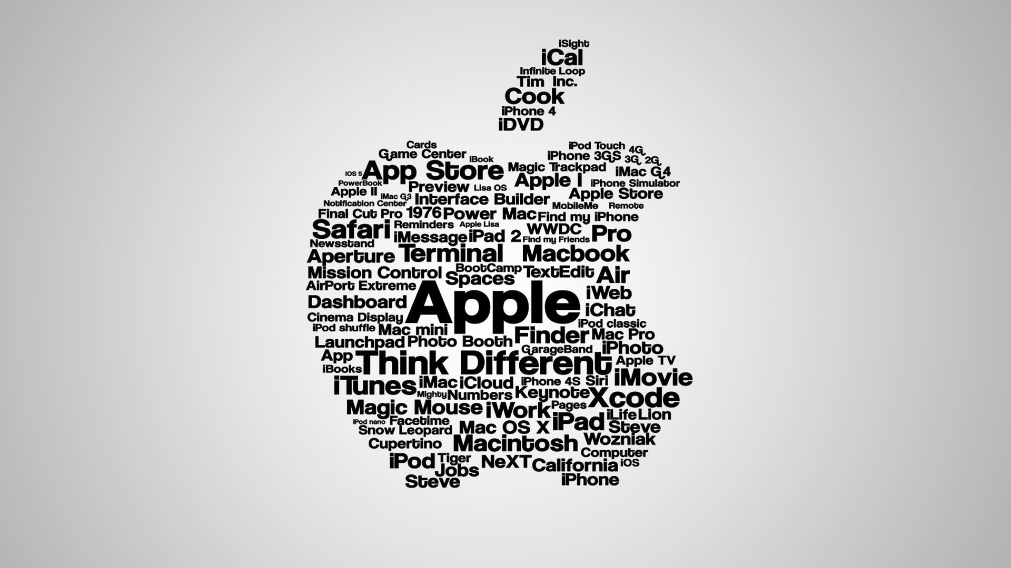

My portfolio
Apple Inc.
One of the largest tech firms in the U.S., with hands in personal computing and other technologies
Surveys show that over half of the homes in the U.S. own at least 1 Apple product
Starbucks Corporation
Major coffee chain that sells coffee/tea and coffee/tea related products
The busiest Starbucks in the United States is also the first Starbucks ever established (Pikes Place Starbucks), and averages $72,000 a week

Slide 3
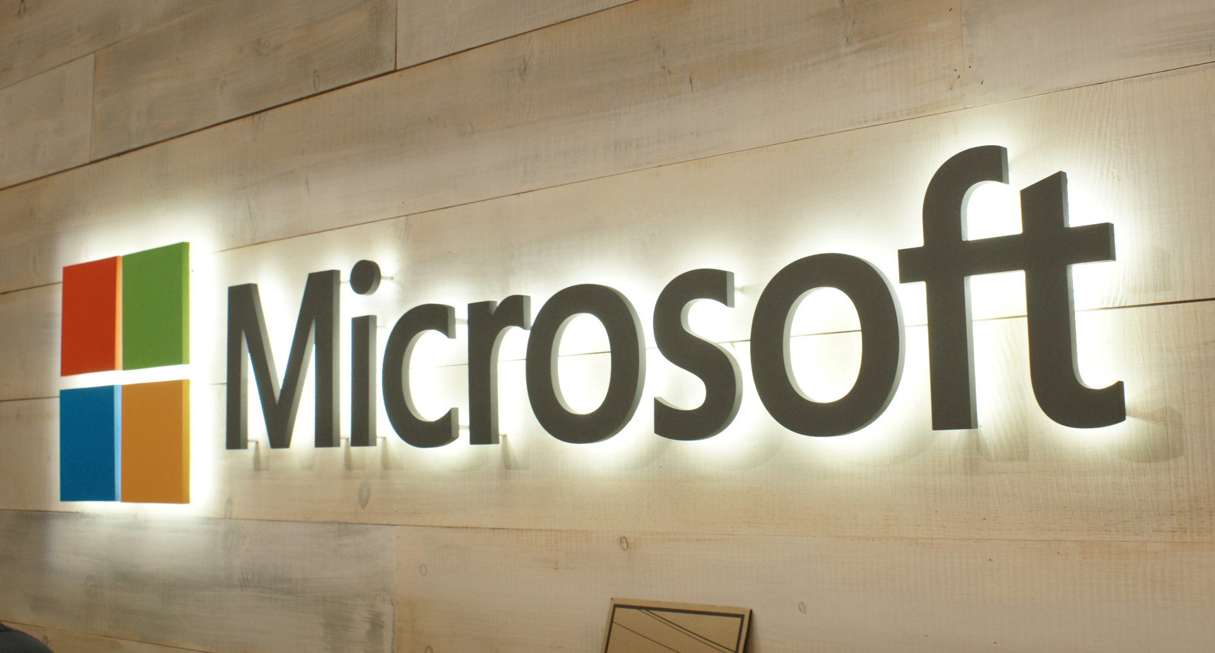


Microsoft
A major tech company, creator of the widely used Windows operating system as well as various other technologies
Founded in 1975 by two people, one of which is now one of the richest men in the world (Bill Gates)
Tiffany and Co.
Major jeweler in the world
In addition to jewelry, they sell watches, stationary, china, crystal, etc.
Twitter
A very popular and rising social network provider
The most followed celebrity on Twitter is Katy Perry, with 86,480,870

Slide 4

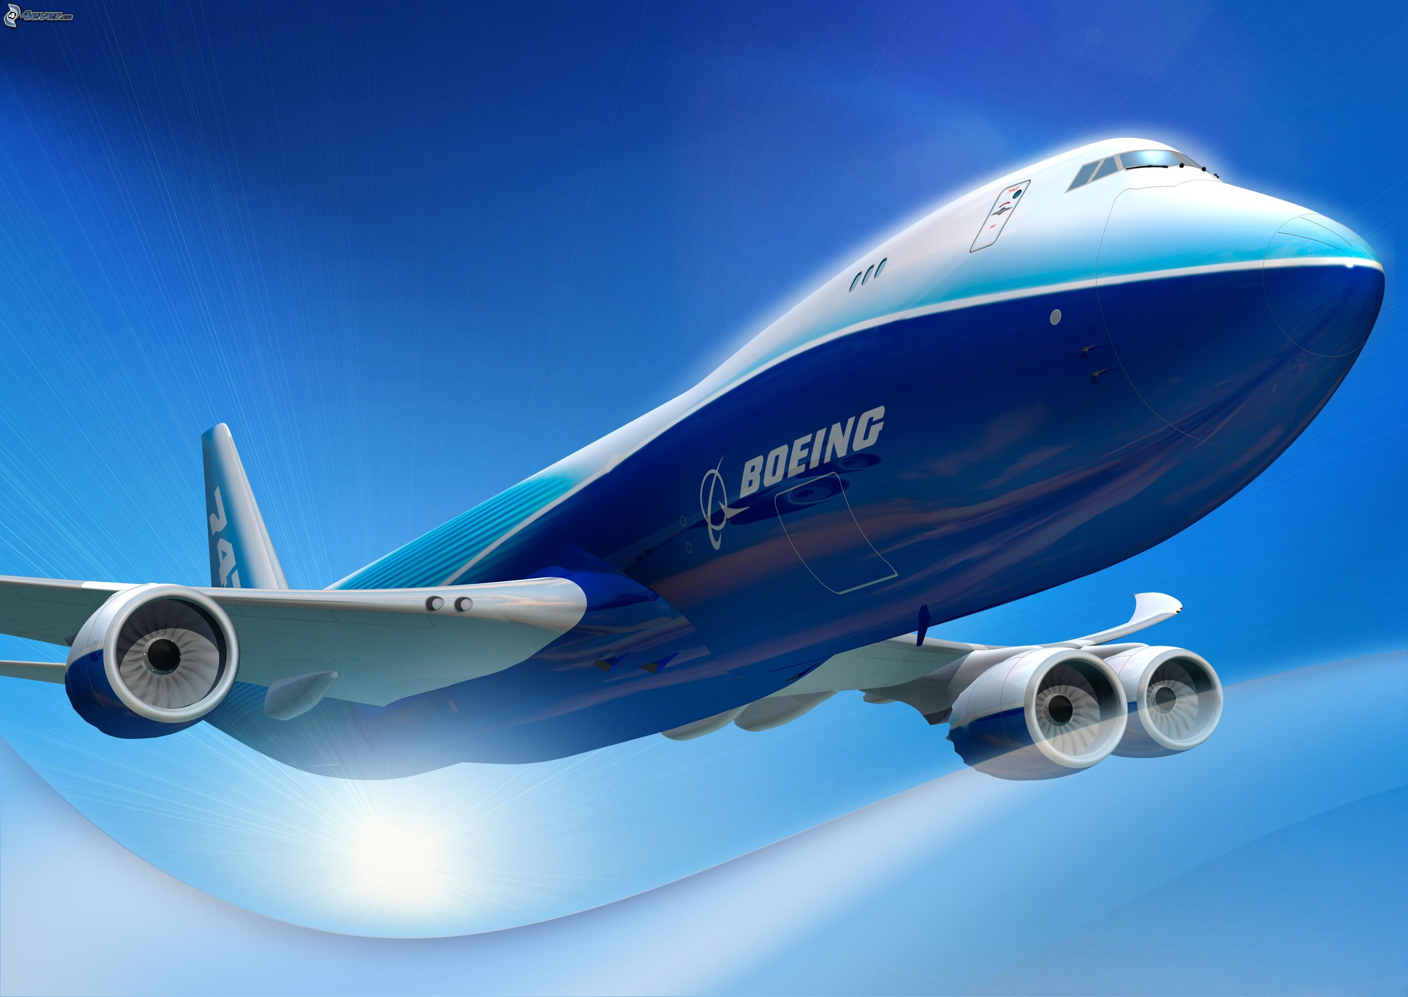

Goldcorp Inc.
Corporation involved in obtaining, processing, and selling gold
Also deals with other raw materials (silver, copper, lead, zinc)
Boeing Inc.
Major manufacturer of airplanes and other aviation related products
Creator of the 747 and other major commercial airplanes
3D Systems Corporation
Company that provides 3D printing software and products
In addition to more mechanical based 3D templates, they develop many health-related templates for surgery and other health uses

Slide 5
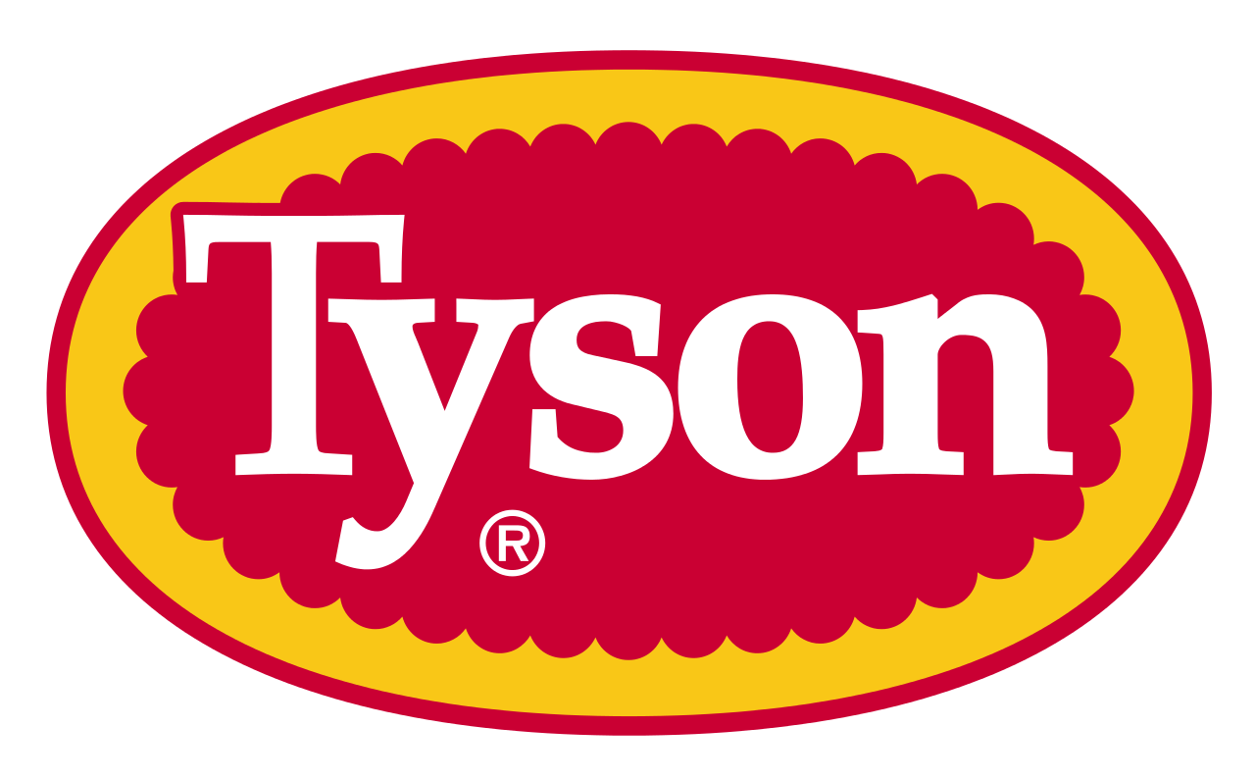

Tyson Foods, Inc.
Food production company operating in five areas: Chicken, Beef, Pork, Prepared Foods and International
Started in the 1930s selling produce and food products from the back of a truck
Verizon Communications Inc.
provides communications, information and entertainment products and services to consumers, businesses and governmental agencies
Verizon’s total number of employees (nearly 177,000) is about the size of the population of Providence, R.I.

Slide 6
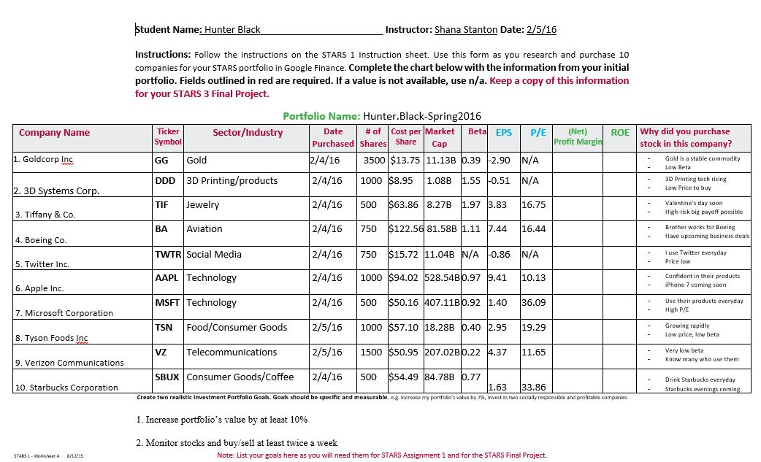
My initial Portfolio

Slide 7
My goals
Goal 1: Increase my portfolio’s overall value by at least 10 %
Goal 2: Monitor stocks and buy/sell at least twice a week
I met the first of the goals above by increasing the value of my portfolio by 12.07% in the end, and the second of these goals by monitoring my stocks roughly 2-3 times each week. I did not, however, see any reason throughout the time of this project to buy or sell any of my stocks, according to the criteria of monitoring my portfolio that I laid out previously.
Explain why your portfolio goals should be specific and measurable. The goals above should be specific and measurable so that it is easy to tell how far you have come in accomplishing these goals, and whether or not you have completed these goals or not.

Slide 8
Monitoring My portfolio
When analyzing my portfolio throughout the project, the main thing I was looking at were week long trends of my stocks. Essentially, I would look at how each of my stocks did after a single week and if they were up or only very slightly down overall, I would leave them be. If I were to see a major drop in any of my stocks for 2 consecutive weeks, I planned on selling those stocks for some of my backup stocks I had in mind.
If this were my actual money, I would most likely monitor my portfolio daily and do what I described above with a shorter time period, probably around 2-3 days.

Slide 9
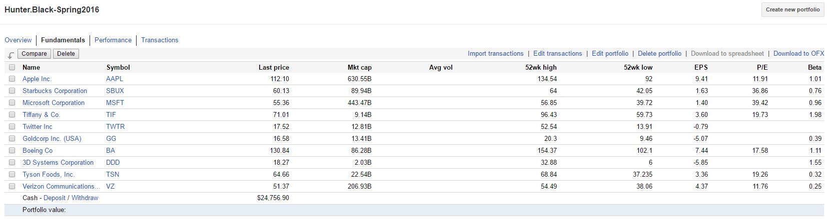
MY Portfolio’s Fundamentals

Slide 10
Fundamentals Discussion
Market Cap - Market cap is the total value of all of the shares of stock of a company, found by multiplying the price of the stock by the total number of outstanding shares. This allows comparison of different companies to see who is larger/smaller.
Beta - Generally speaking, beta is how risky a company is in the current market. A beta of less than 1 are less risky, a beta larger than 1 is more risky. The company with the highest beta at the beginning (Tiffany & Co.), ended up returning 9.79% in the end.
Risk – Risk is how “volatile” a company is in the market, or how likely a radical change could happen to the company in the market. Generally, companies with high risk have the potential for very high rewards, but very high consequences, while low risk offers a more stable return. It is closely tied to beta.
Diversification - Diversification is essential to a successful long-term portfolio. This is mainly because if a sector of the market is hit hard (as was seen with the oil sector earlier this course), mostly all stocks associated with that sector lose value. By diversifying, you have a better chance of staying above the market if a sector is hit hard. I diversified my portfolio by choosing companies with ties to technology, consumer goods, aviation, food, raw materials, and communication.

Slide 11
Fundamentals Discussion
Use this slide to discuss and analyze the following terms.
EPS - (Earnings per share) This is the companies profit divided by the total number of outstanding shares. This can be used to understand how much each share is actually worth
P/E - (Price to earnings ratio) This is found by dividing the market value per share of a company by the EPS. Put simply, it tells whether a companies stock price is over or undervalued. It can be used “to determine a stocks future prospects”(Investopedia).
Highest EPS in ending portfolio: Apple The main factor that could increase the EPS of a company is a jump in profit of the company, thus causing the above equation to be weighted more to the numerator, yielding a higher overall EPS. In Apple’s case, this could be due to their recent press conference where they unveiled their new line of products for the year: the iPhone SE, a smaller version of their iPad Pro, and the Apple Pencil, all of which were available for purchase about a month ago.
Lowest P/E in ending portfolio: Verizon Communications
With Verizon being essentially a household name nowadays, and with a beta value of 0.25, it is not hard to see why the companies P/E is so small. The company has not seen very much exponential growth recently, and most likely won’t anytime soon due to the every growing “cutting-the-cable” generation.

Slide 12
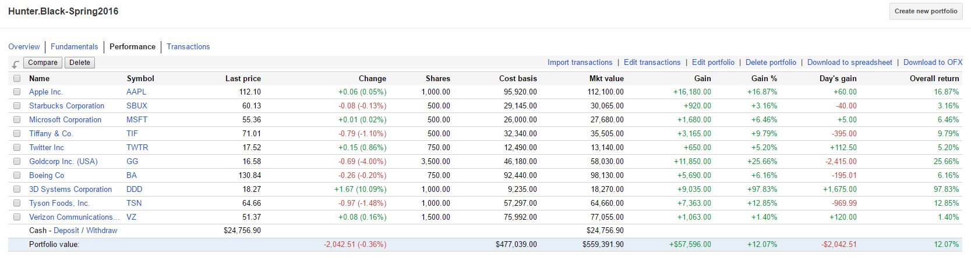
My Portfolio’s Performance

Slide 13
Performance Discussion
Evaluation of portfolio’s performance:
Total Gain: $57,596.00 The total overall profit of my portfolio in the end.
Overall Value: 12.07% The overall percentage difference from start to finish of my portfolio
Company with greatest percent gain: 3D Systems Corporation (97.83%)
This could be due to the fact that, starting out, this company was small in the grand scheme of things, so they had more ground to cover on the way up.
Company with greatest percent loss: N/A All companies in my portfolio had an overall gain, with the smallest gain being Verizon Communications (1.40%).

Slide 14

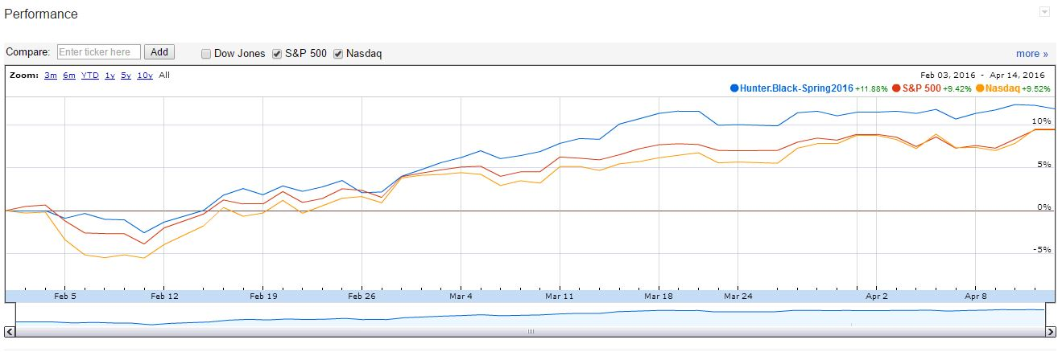
Market Performance Comparison
Start date: February 3, 2016 End date: April 14, 2016

Slide 15
Market performance discussion
NASDAQ: The average stock performance of roughly 4,000 stocks. Also the name of a market to trade on (mainly online)
S&P 500: (Standard & Poor’s 500) Index based off of 500 large stocks on both the NYSE and NASDAQ
In comparing my portfolio to NASDAQ and The S&P 500 over the period of this project, I can get a rough idea of how my portfolio faired in relation to the market as a whole. In the beginning, my portfolio followed the trend of the market and fell until about February 10th, where it continually grew (following the trend of the market again). Throughout this whole time, my portfolio stayed above both the NASDAQ index and The S&P 500. Thus, overall my portfolio was successful in the market from start to finish.
The reason for comparing my portfolio with two different indices is due to the fact that the major indices, while some do include the same stocks, generally look at different stocks to get their measurements. By comparing to at least two, it is clearer overall how my portfolio did across the board, and in this case in more than one market (NASDAQ).

Slide 16
Portfolio News/Fraud
Identify and discuss how the news and world events impacted your portfolio by answering the questions below.
Include the news headline for questions #1 and #2 (example below). Answer all 3 questions.
Company Impact – Briefly discuss one important news story that had a big impact on one or more companies in your portfolio.
Stock Market Impact – Briefly discuss one world event or news story that impacted the market(s) while monitoring your portfolio.
Did fraud impact any of the companies in your portfolio? If yes, please explain. If no, provide an explanation on how fraud can impact your portfolio.
Example: Target - Fraud Jan. 29, 2014 U.S. attorney general confirms investigation of Target Corp data breach-Reuters The U.S. AG is investigating the hacking of consumer data and hopes to find perpetrators. (Include more information if relevant.)

Slide 17
My Observations
Observation 1: With a basic understanding of the lingo of the stock market, it is much easier to “comfortably” make a decision when buying a stock
Observation 2: Some stocks which I thought would have large, lasting gains did not(not the ones I invested in, but ones I watched for potential buy/sell opportunities), such as Disney with the release of the new Star Wars movie.
Observation 3: Constant observation of my portfolio was something unobtainable to me, and something which quite frankly I was OK with. I would not want to be a day-trader due to the stress of watching numbers go up and down all day.
Observation 4: Through doing this project, I am interested in playing around on the stock market with small amounts of money after I get a steady job.

Slide 18
My Future
Application of this project in my future investing:
1. Having learned what all of the symbols mean and how to measure them, I have a better understanding of how the market functions and can thus make better, smarter decisions when investing in the future.
2. Based on the stocks that I thought would do well in this project, I have a better understanding of how they perform on a small scale. In the future if I choose to invest in them, I will have some previous knowledge of their performance.
3. If my future employer offers a retirement plan in which I choose where the funds of which are invested, I will have a working knowledge of how specific sectors work.
4. After this project, I have decided I would not want to have day-trader as a profession due to the high levels of stress I can imagine those employed in that field experience.

Slide 19
Works cited
Pachal, Peter. "Half of U.S. Households Own at Least One Apple Product."CNN. Cable News Network, 29 Mar. 2012. Web. 13 Apr. 2016.
Twitter. "Top 100 Most Followed Users on Twitter." Twittercounter. Twitter, n.d. Web. 13 Apr. 2016.
Tyson Foods. "Tyson Foods: Our Story." Tyson Foods: Our Story. Tyson Foods, n.d. Web. 13 Apr. 2016.
Verizon. "Six Surprising Facts About Verizon." Six Surprising Facts About Verizon. Verizon, 30 Jan. 2014. Web. 13 Apr. 2016.
Fidelity. "Understanding Market Cap - Fidelity." Understanding Market Cap - Fidelity. Wealth Management Systems, Inc., n.d. Web. 14 Apr. 2016.
Investopedia. "How To Use The P/E Ratio And PEG To Tell A Stock's Future | Investopedia." Investopedia. Investopedia, 28 Dec. 2003. Web. 14 Apr. 2016.

